Slide 1
Hand Tool Study Guide

Slide 2
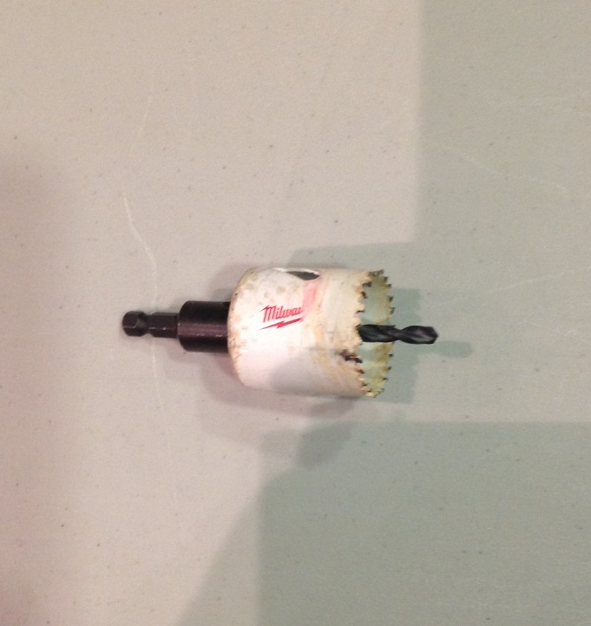
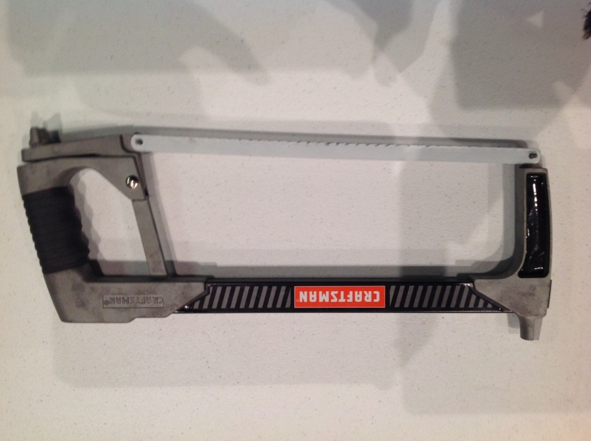
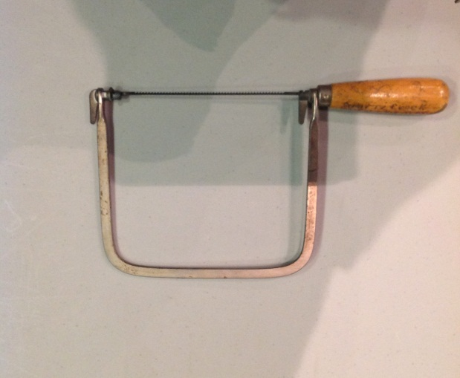
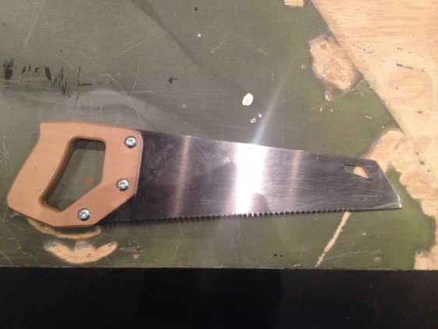
Saws
Hole Saw
(Is A Drill Bit)
Hack Saw
Coping Saw
Crosscut Saw
Close inspection of teeth shows they are going opposite directions making it a crosscut

Slide 3
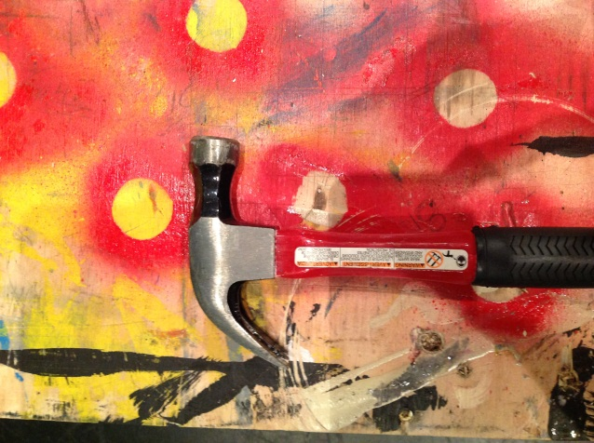
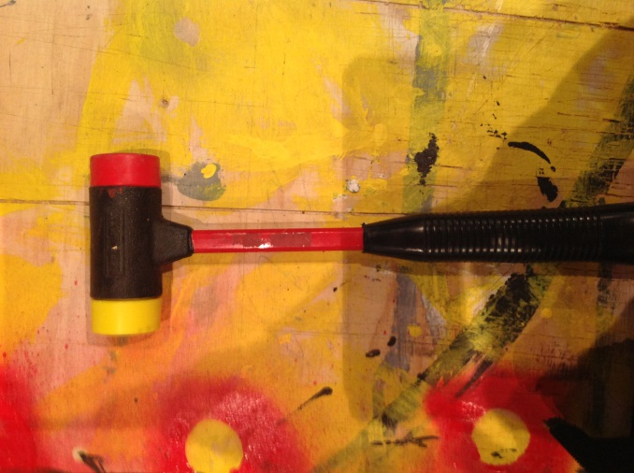
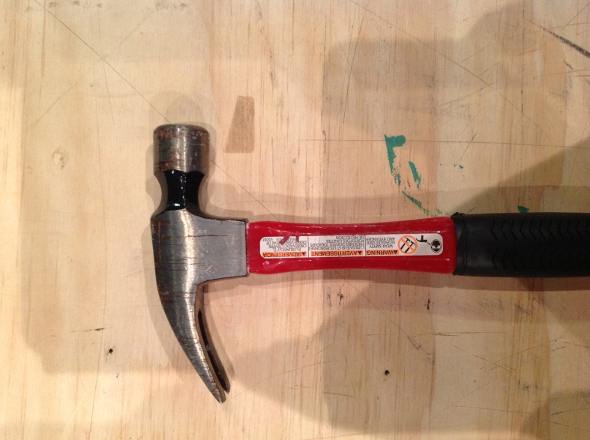
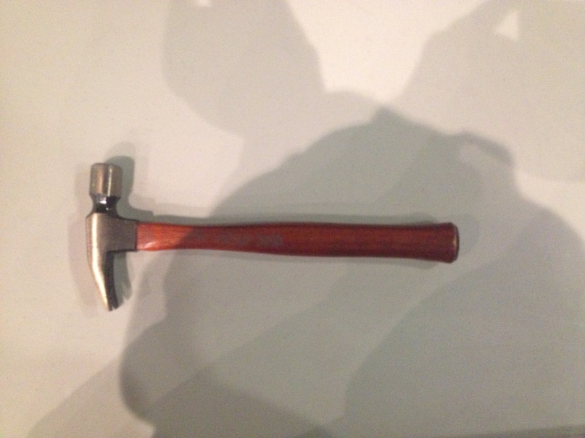
Hammers
Claw Hammer
Mallet
Rip Hammer
Tack Hammer

Slide 4
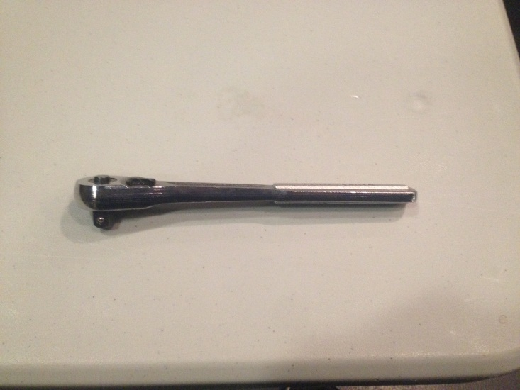
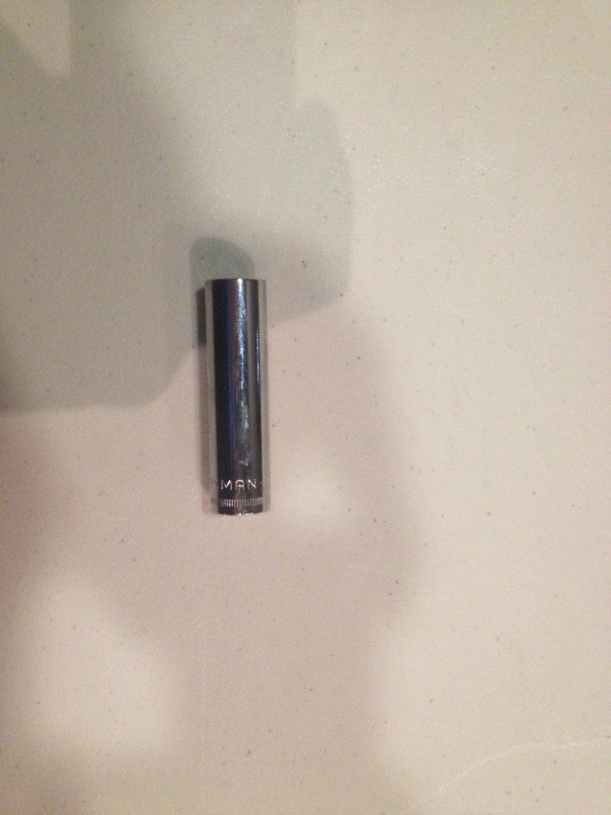
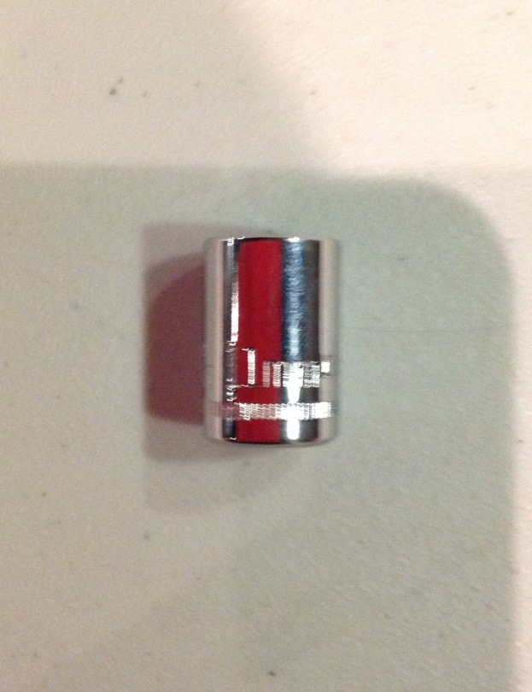
Ratchet and Sockets
A standard socket have fractions on it. Metric have millimeters(mm) on them.
Shallow well socket
Deep well socket
Ratchet
These can have different sized sockets that will go on
The sockets can also change from metric to standard sizes

Slide 5
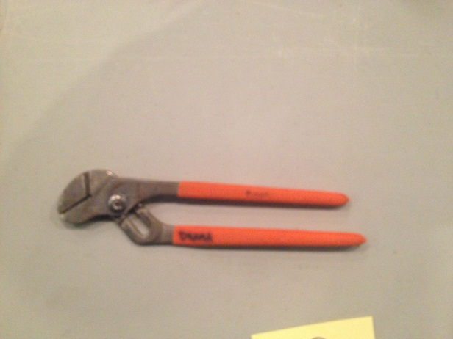
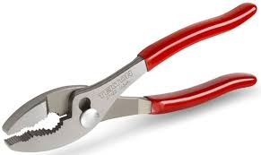
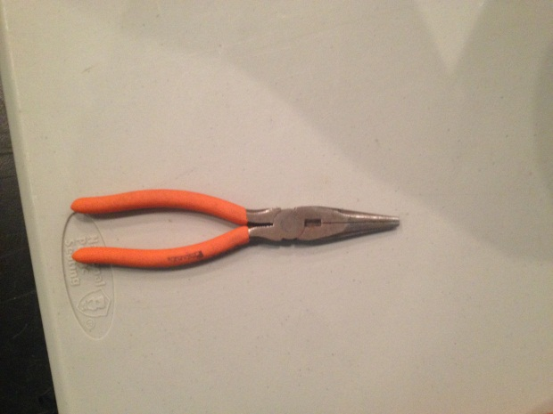
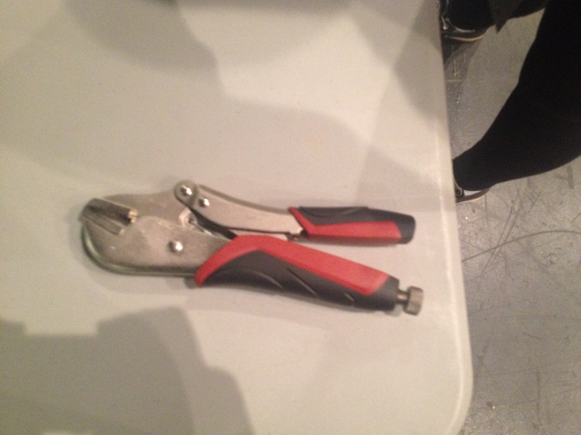
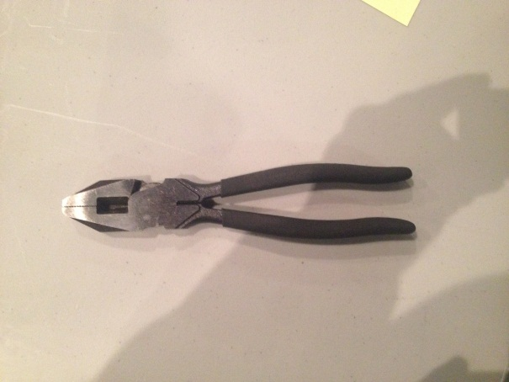
Pliers
Tongue and Groove Pliers
Slip-Joint Pliers
Needle-Nose Pliers
Vice Grips
Linesmen Pliers

Slide 6
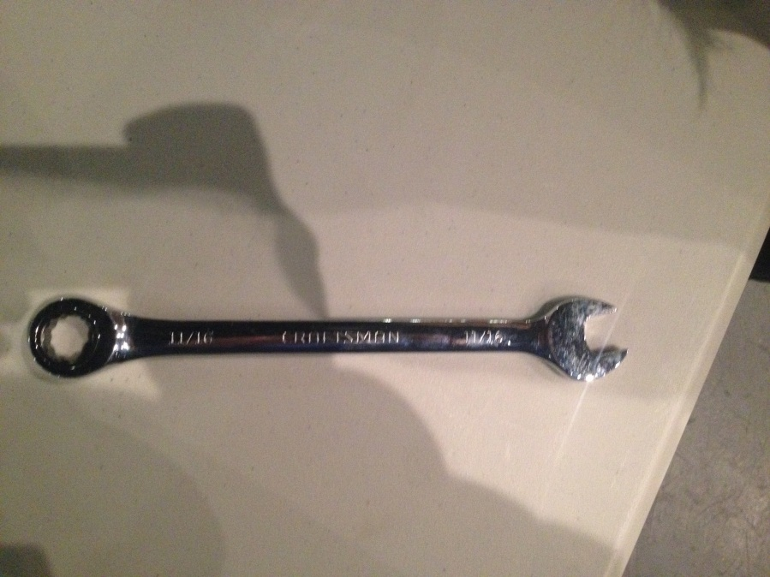
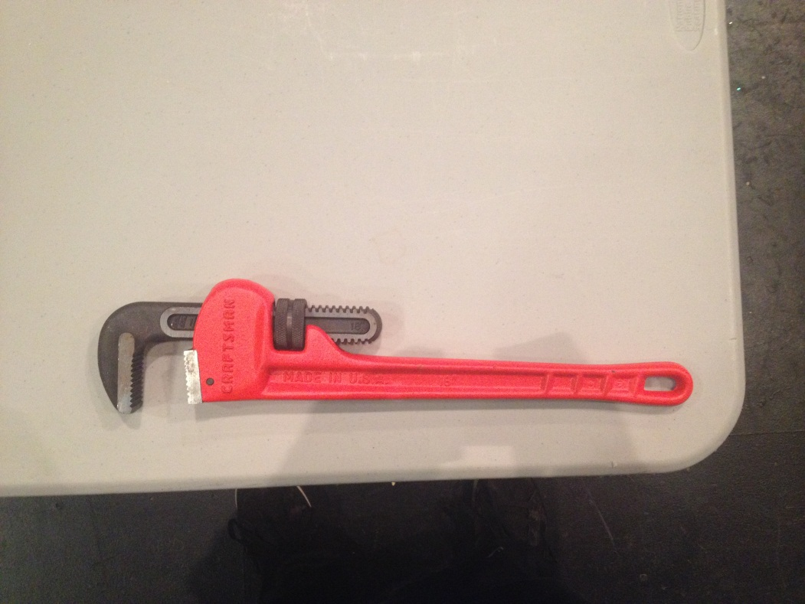
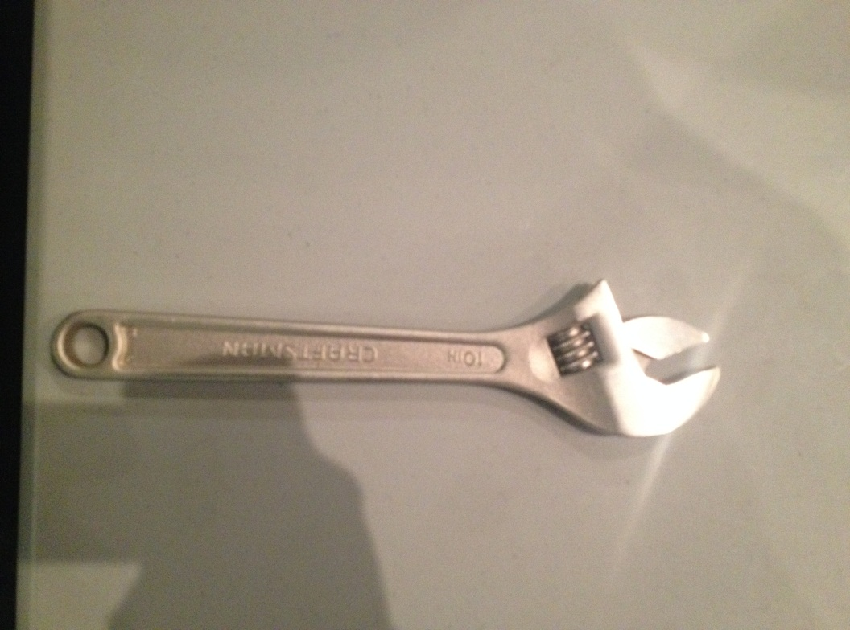
Wrenches
Combination Wrench
Pipe Wrench
Crescent Wrench

Slide 7
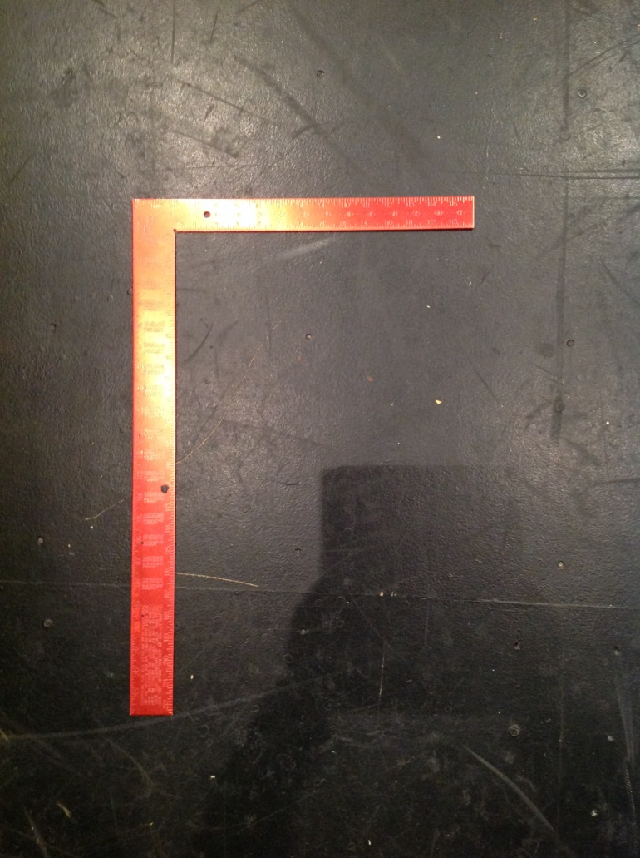
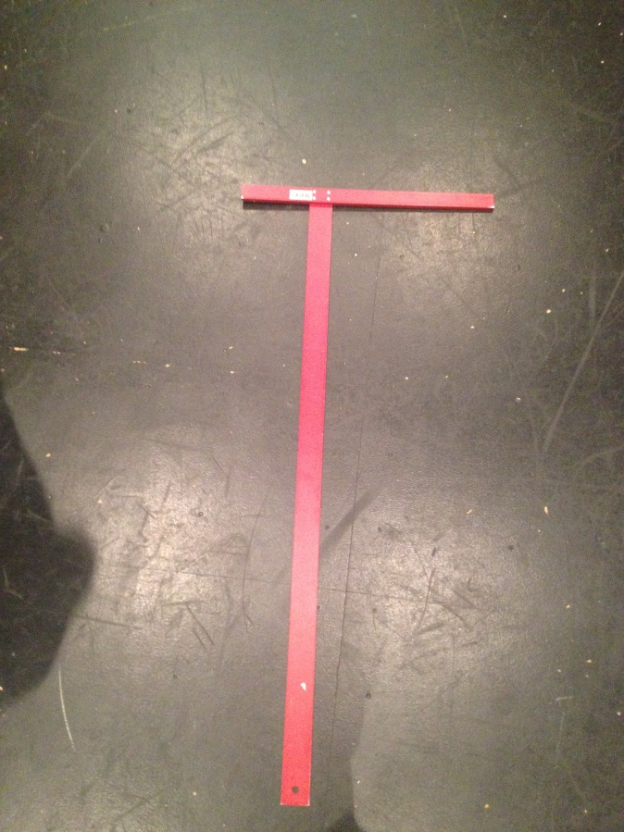
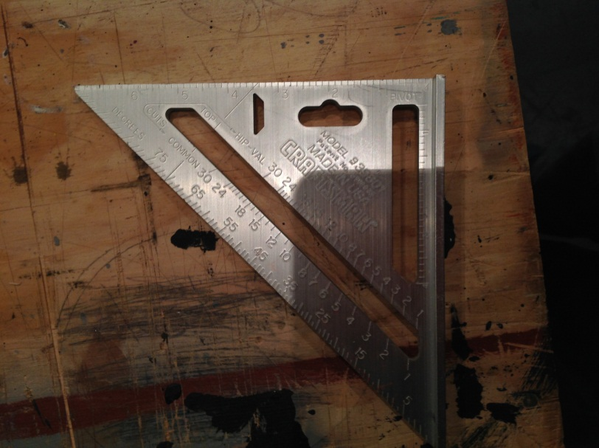
Squares
T-Square
Framing Square
Speed Square

Slide 8
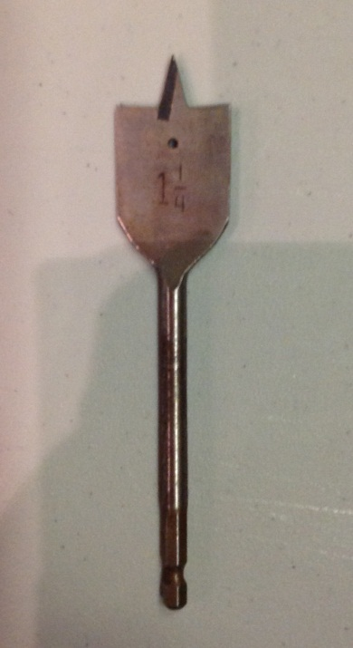
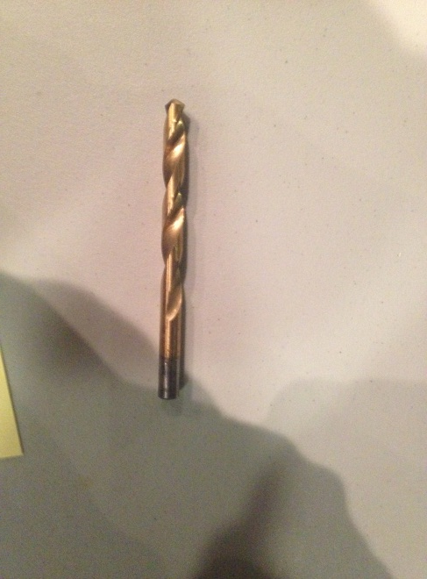
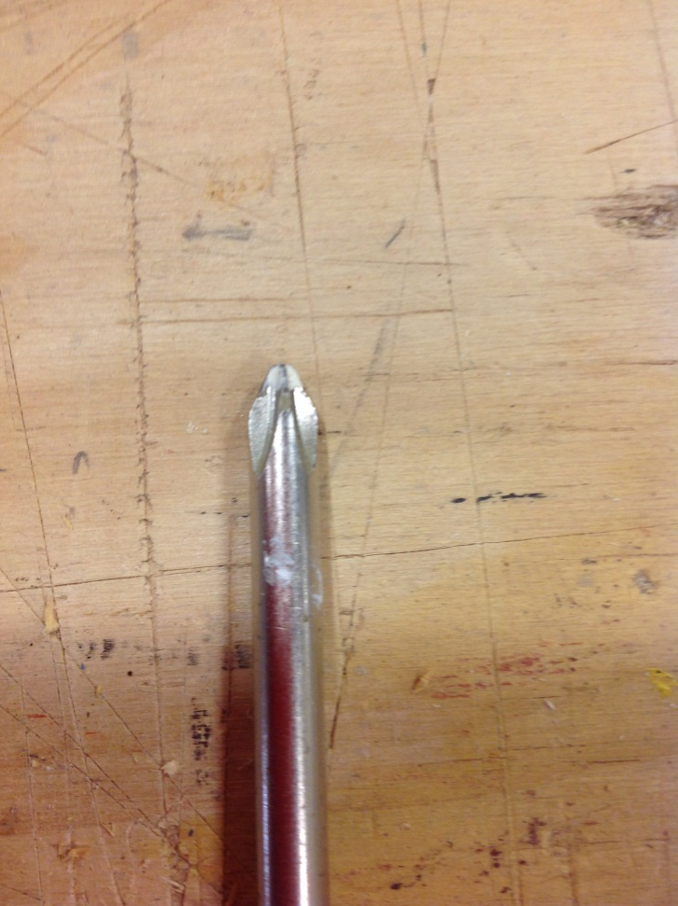
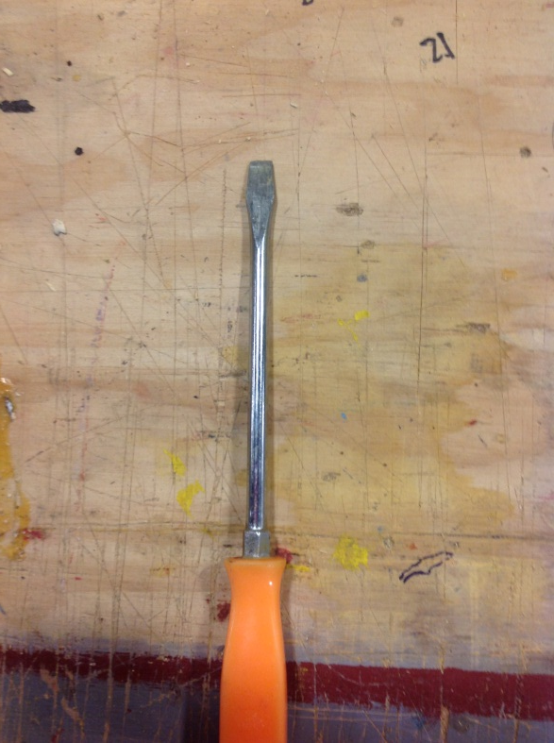
Screwdrivers And Bits
Twist Bit
Spiral Bit
Wood Bit
Spade Bit
Standard Screwdriver
Flathead Screwdriver
Slotted Screwdriver
Phillips Screwdriver

Slide 9
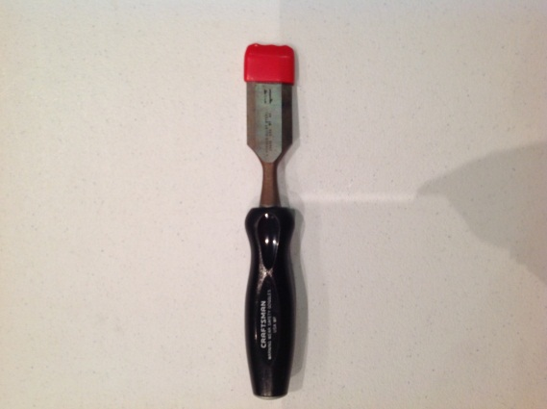
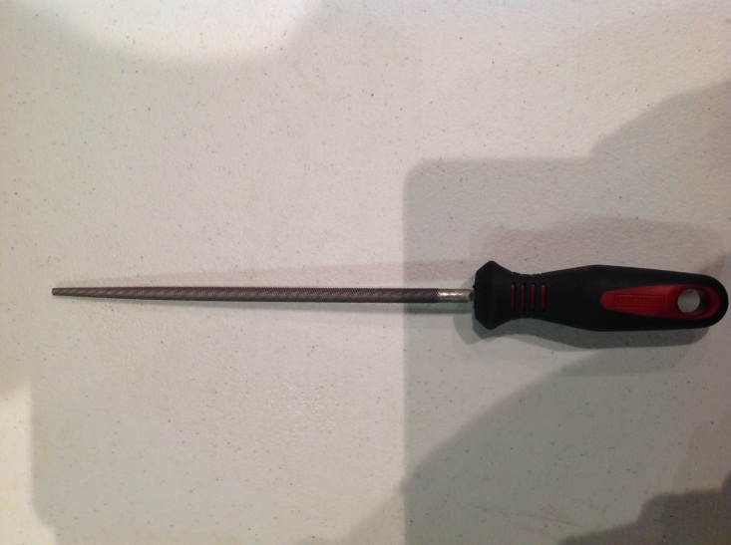
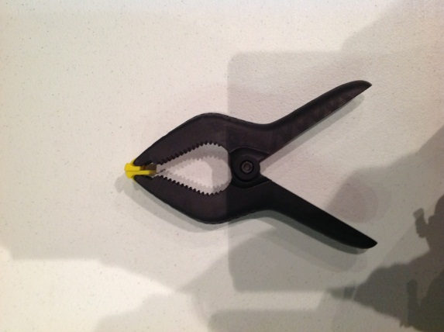
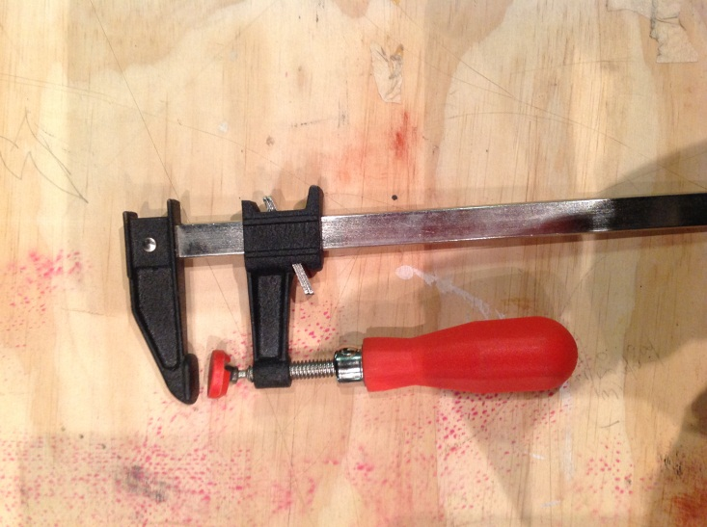
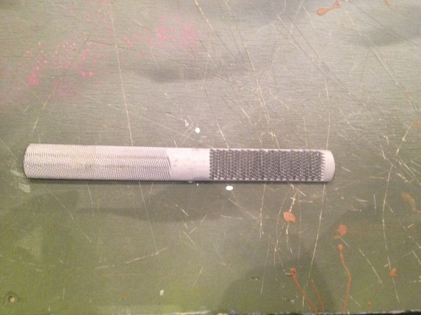
Chisels/Files/Clamps
Wood Chisel
Rat Tail File
Spring Clamp
Sliding Bar Clamp
Combination File
Right Side – Rasp
Left Side – Wood File

Slide 10
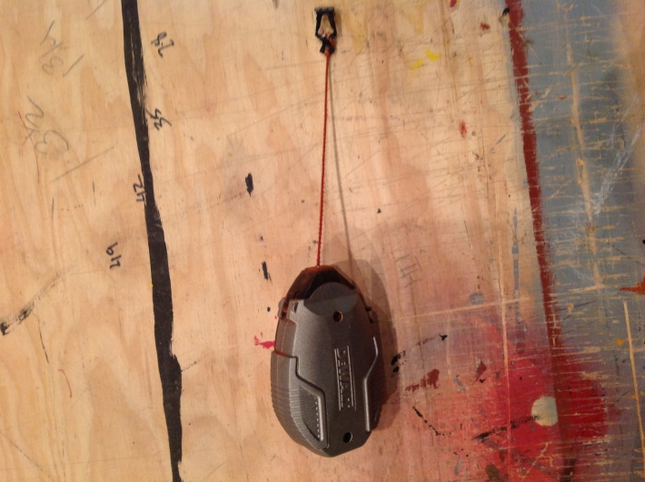
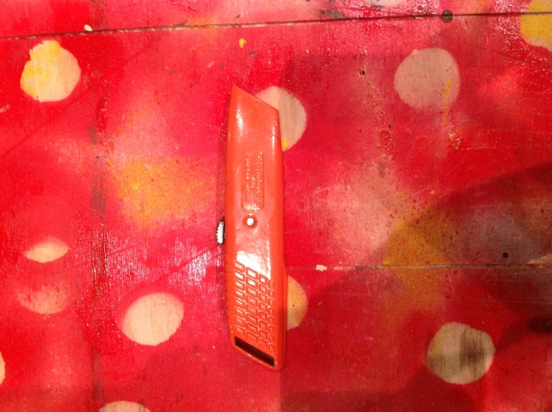
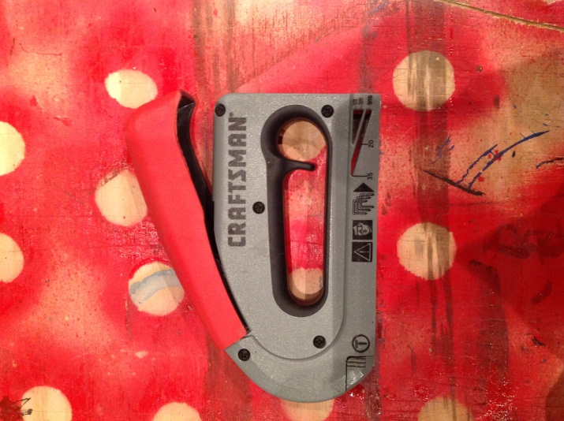
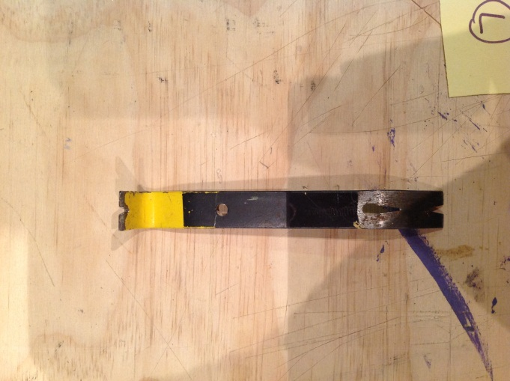
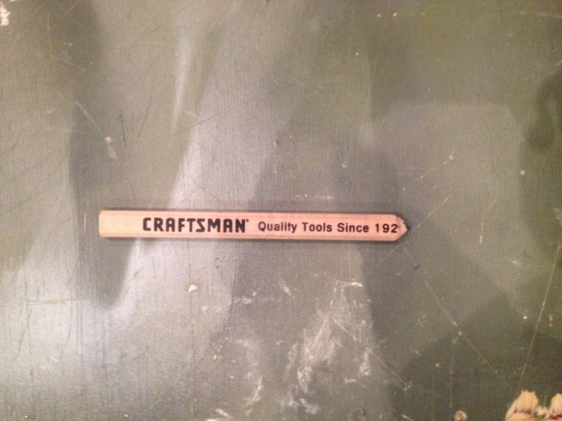
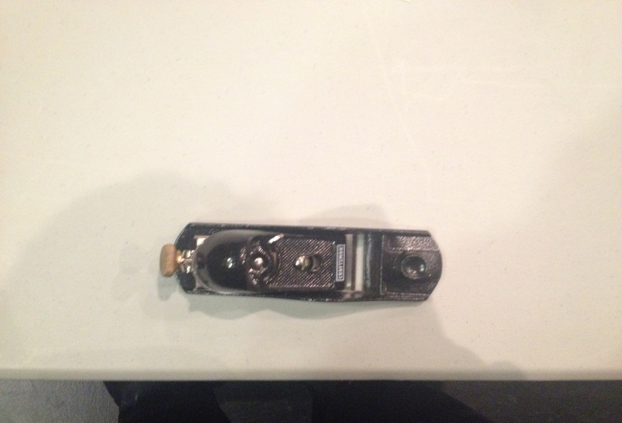
Miscellaneous
Chalk Line
Pry Bar
Utility Knife
Carpenters Pencil
Staple Gun
Wood Plane

Slide 11
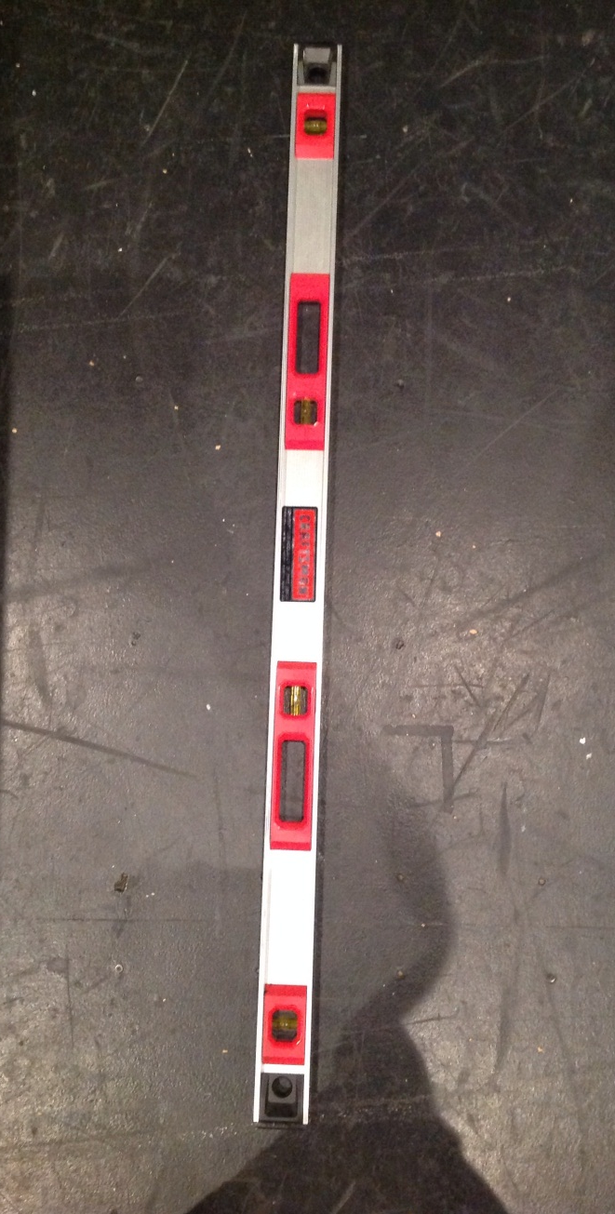
Miscellaneous Part Two
Carpenters Level

Slide 12
Created By Tristan Hendricks And Nic Jarrad

